Slide 1
Reference Models
Lecture -3-4 (Theory)
Department of Computer Science and Engineering,
Chitkara University, Punjab
Prepared by
Dr. Neha Sharma (CSE)

Slide 2
Index
Operating System
Protocols and Models
Reference model
Seven-Layers of OSI(Open System Interconnection)
Concept of Layers
Benefit of using layered Models
Summary of layers
Protocols used at each layer
Protocol Data Unit (PDU)

Slide 3
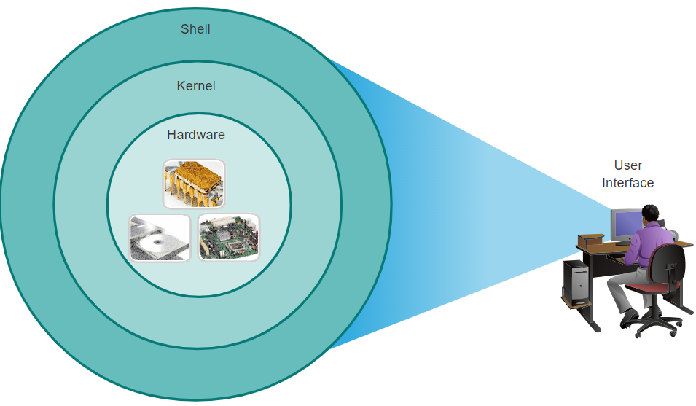
Operating Systems (OS)
All end devices and network devices require an operating system (OS). As shown in the figure 1, the portion of the OS that interacts directly with computer hardware is known as the kernel. The portion that interfaces with applications and the user is known as the shell. The user can interact with the shell using a command-line interface (CLI) or a graphical user interface (GUI).
Figure 1 Operating system interacts with hardware, kernel, and Shell.
Shell: The user interface that allows the user to request specific tasks from the computer. These requests can be made either through CLI or GUI interfaces.
Kernel: Communication between hardware and software of a computer and manages how hardware resources are used to meet software requirements.
Hardware: The physical part of a computer including underlying electronics.
Note: The operating system on home routers is usually called firmware. The most common method for configuring a home router is by using a web browser-based GUI.

Slide 4
Protocols and Models
How a network device operates within a network?
A network device is a node in the wireless mesh network. It can transmit and receive wireless data and perform the basic functions necessary to support network formation and maintenance.
Communications Fundamentals - Networks vary in size, shape, and function. For communication to occur, devices must know “how” to communicate, three elements in common:
Message source (sender) - Message sources are people, or electronic devices, that need to send a message to other individuals or devices.
Message Destination (receiver) - The destination receives the message and interprets it.
Channel - This consists of the media that provides the pathway over which the message travels from source to destination.
Sending a message, whether by face-to-face communication or over a network, is governed by rules called protocols. Protocols must account for the following requirements to successfully deliver a message that is understood by the receiver: An identified sender and receiver, Common language and grammar, Speed and timing of delivery, Confirmation or acknowledgment requirements.

Slide 5
Protocols and Models
Network Protocol Requirements - Common computer protocols include the following requirements:
Message encoding
Message formatting and encapsulation
Message size
Message timing
Message delivery options

Slide 6
Network Protocol Overview
Protocols are implemented by end devices and intermediary devices in software, hardware, or both. Each network protocol has its function, format, and rules for communications.
The table lists the various types of protocols that are needed to enable communications across one or more networks.
Protocol Type | Description
Network Communications Protocols | Protocols enable two or more devices to communicate over one or more networks. The Ethernet family of technologies involves a variety of protocols such as IP, Transmission Control Protocol (TCP), HyperText Transfer Protocol (HTTP), and many more.
Network Security Protocols | Protocols secure data to provide authentication, data integrity, and data encryption. Examples of secure protocols include Secure Shell (SSH), Secure Sockets Layer (SSL), and Transport Layer Security (TLS).
Routing Protocols | Protocols enable routers to exchange route information, compare path information, and then to select the best path to the destination network. Examples of routing protocols include Open Shortest Path First (OSPF) and Border Gateway Protocol (BGP).
Service Discovery Protocols | Protocols are used for the automatic detection of devices or services. Examples of service discovery protocols include Dynamic Host Configuration Protocol (DHCP) which discovers services for IP address allocation, and Domain Name System (DNS) which is used to perform name-to-IP address translation.
The functions of these protocols are addressing, reliability, flow control, sequencing, error detection,
and application interface.

Slide 7
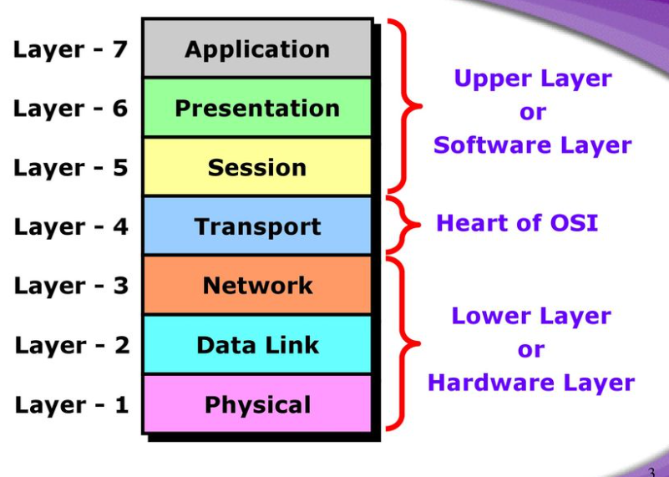
OSI Reference Model
Figure 2 OSI Reference Model

Slide 8
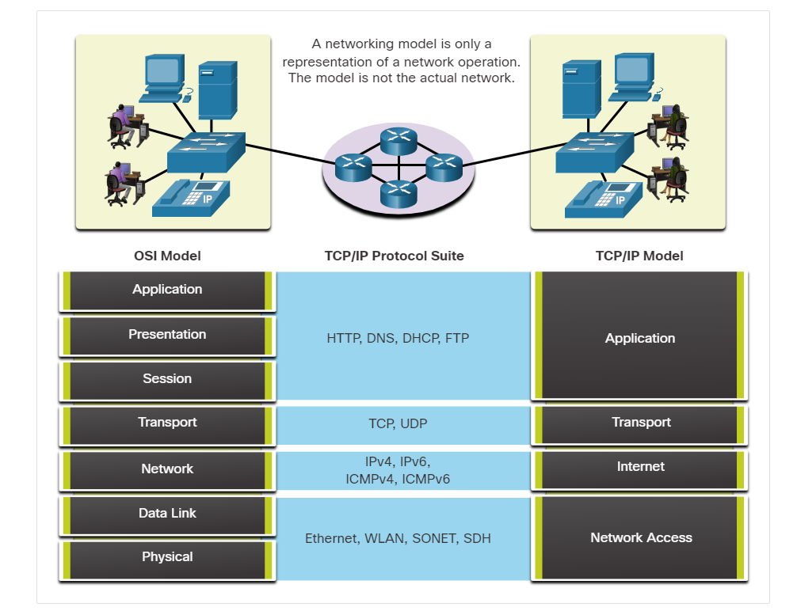
Benefit of using layered model
These are the benefits of using a layered model to describe network protocols and operations as shown in Figure 3:
Assisting in protocol design because protocols that operate at a specific layer have defined information that they act upon and a defined interface to the layers above and below
Fostering competition because products from different vendors can work together
Preventing technology or capability changes in one layer from affecting other layers above and below
Providing a common language to describe networking functions and capabilities
Two layered models used: Open System Interconnection (OSI) Reference Model and TCP/IP Reference Model
Figure 3 Shows network protocols and operations of layered model

Slide 9
OSI Reference Model
OSI Reference Model - Internationally Standardized Network Architecture.
OSI = Open Systems Interconnection: deals with open systems, i.e. systems open for communications with other systems.
Specified in ISO 7498.
Model has 7 layers.
Notes:
The OSI model describes the flow of data in a network, from the lowest layer (the physical connections) up to the layer containing the user’s applications. Data going to and from the network is passed layer to layer. Each layer is able to communicate with the layer immediately above it and the layer immediately below it. This way, each layer is written as an efficient, streamlined software component. When a layer receives a packet of information, it checks the destination address, and if its own address is not there, it passes the packet to the next layer.
When two computers communicate on a network, the software at each layer on one computer assumes it is communicating with the same layer on the other computer. For example, the Transport layer of one computer communicates with the Transport layer on the other computer. The Transport layer on the first computer has no regard for how the communication actually passes through the lower layers of the first computer, across the physical media, and then up through the lower layers of the second computer.

Slide 10
7-Layer OSI Model
Figure 4 displays 7 layers of OSI model and overview of their specific task.
Layer 7
Application Layer
Layers 1-4 relate to communications technology.
Layers 5-7 relate to user applications.
Layer 6
Presentation Layer
Layer 5
Session Layer
Layer 4
Transport Layer
Layer 3
Network Layer
Layer 2
Data Link Layer
Layer 1
Physical Layer
Figure 4 Shows OSI model layers
Communications subnet boundary
Notes:
The Application layer represents the level at which applications access network services. This layer represents the services that directly support applications such as software for file transfers, database access, and electronic mail.
∙ The Presentation layer translates data from the Application layer into an intermediary format. This layer also manages security issues by providing services such as data encryption, and compresses data so that fewer bits need to be transferred on the network.
∙ The Session layer allows two applications on different computers to establish, use, and end a session. This layer establishes dialog control between the two computers in a session, regulating which side transmits, plus when and how long it transmits.
∙ The Transport layer handles error recognition and recovery. It also repackages long messages when necessary into small packets for transmission and, at the receiving end, rebuilds packets into the original message. The receiving Transport layer also sends receipt acknowledgments.
∙ The Network layer addresses messages and translates logical addresses and names into physical addresses. It also determines the route from the source to the destination computer and manages traffic problems, such as switching, routing, and controlling the congestion of data packets.
∙ The Data Link layer packages raw bits from the Physical layer into frames (logical, structured packets for data). This layer is responsible for transferring frames from one computer to another, without errors. After sending a frame, it waits for an acknowledgment from the receiving computer.
∙ The Physical layer transmits bits from one computer to another and regulates the transmission of a stream of bits over a physical medium. This layer defines how the cable is attached to the network adapter and what transmission technique is used to send data over the cable
This partition into ‘lower’ and ‘upper’ layers is a widely used way to distinguish between the communications-oriented layers and the applications- oriented layers.
In fact layers 5 and 6 are often ignored in practical applications (the Internet protocol hierarchy has no equivalents to layers 5 and 6).

Slide 11
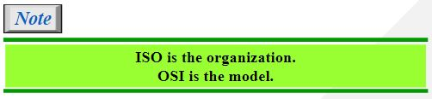
Reference model (OSI)
OSI: Open System Interconnect
Established in 1947, the International Standards Organization (ISO) is a multinational body dedicated to worldwide agreement on international standards. An ISO standard that covers all aspects of network communications is the Open Systems Interconnection (OSI) model. It was first introduced in the late 1970s.

Slide 12
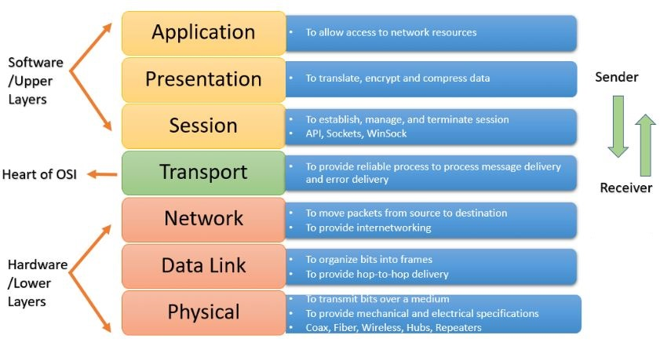
Layers of OSI model
Figure 5 shows responsibilities of OSI model layers
Figure 5 Shows responsibilities of OSI model layers

Slide 13
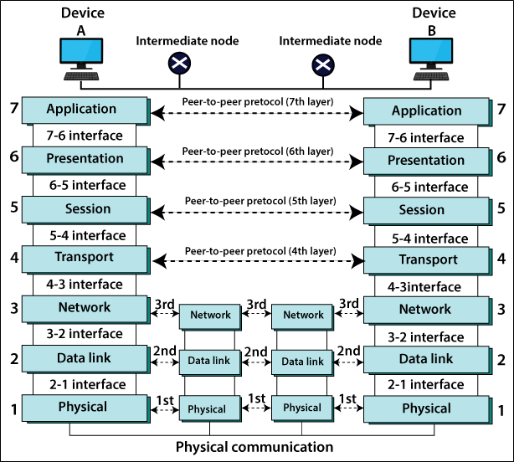
Interaction between layers in OSI model
Figure 6 shows interaction between layers in OSI model at each layer in detail.
Figure 6 Shows interaction between layers in OSI model.

Slide 14
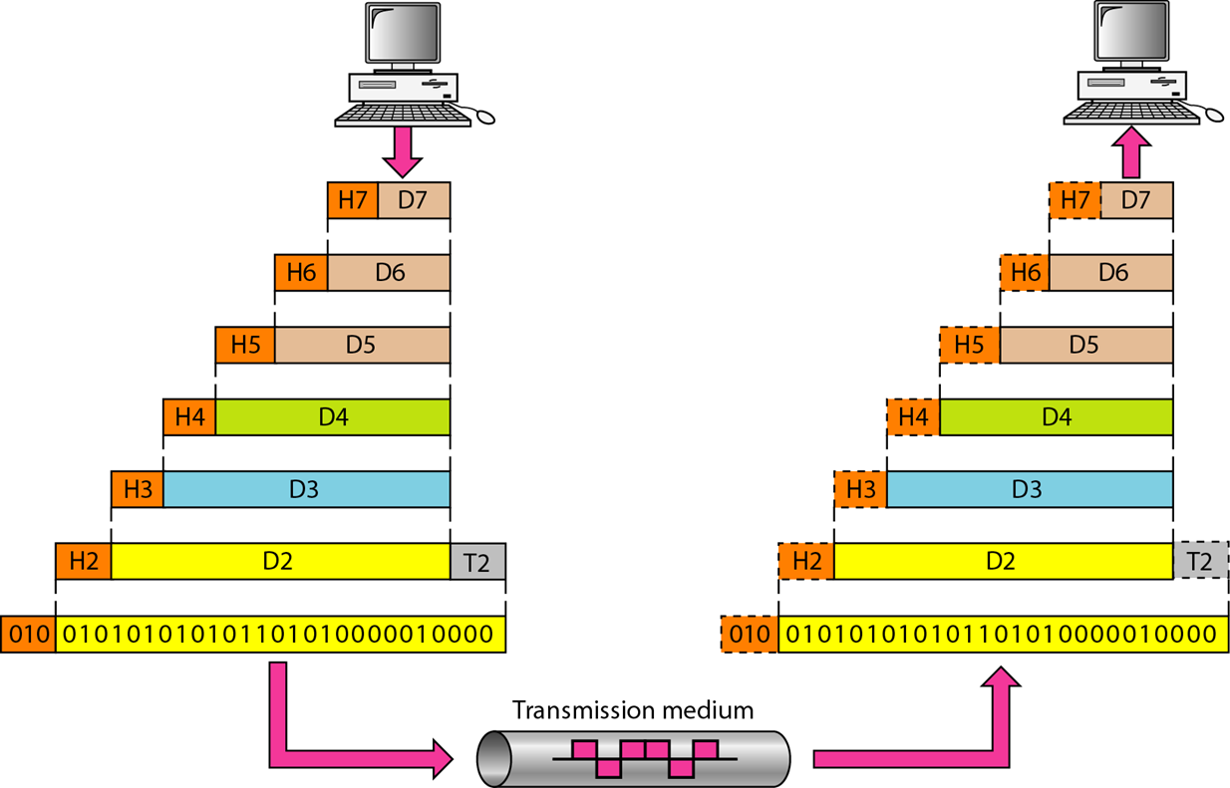
An exchange using the OSI model
Figure 7 shows the exchange of information using OSI model and transmission medium.
Figure 7 Exchange of information using OSI model.

Slide 15
Layers in the OSI model
In this section we briefly describe the functions of each layer in the OSI model.
Physical Layer
Data Link Layer
Network Layer
Transport Layer
Session Layer
Presentation Layer
Application Layer

Slide 16
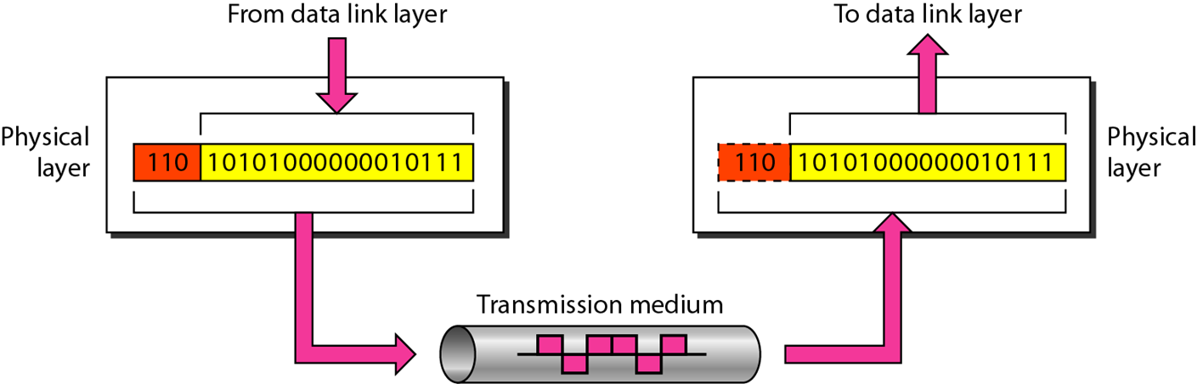

Layer 1 :Physical Layer
Figure 8 Shows the physical layer information transmitted in OSI model.
Note
The physical layer is responsible for movements of individual bits from one hop (node) to the next.

Slide 17
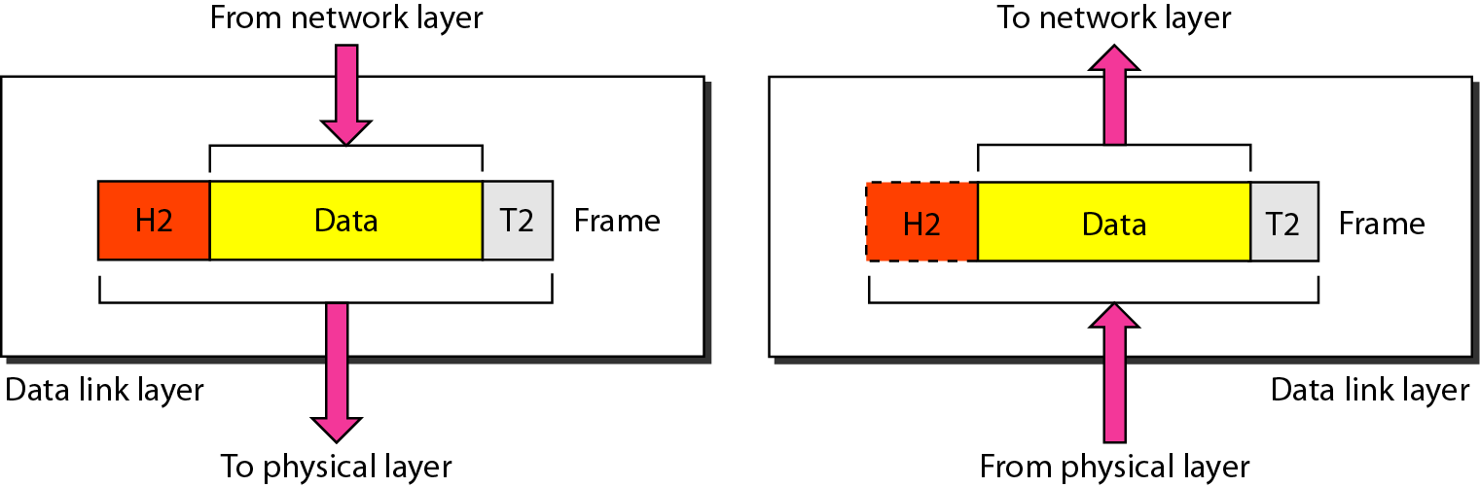
Layer 2 : Data link layer
Figure 9 Shows the data link layer information transmitted in OSI model.
Note
The data link layer is responsible for moving frames from one hop (node) to the next.

Slide 18
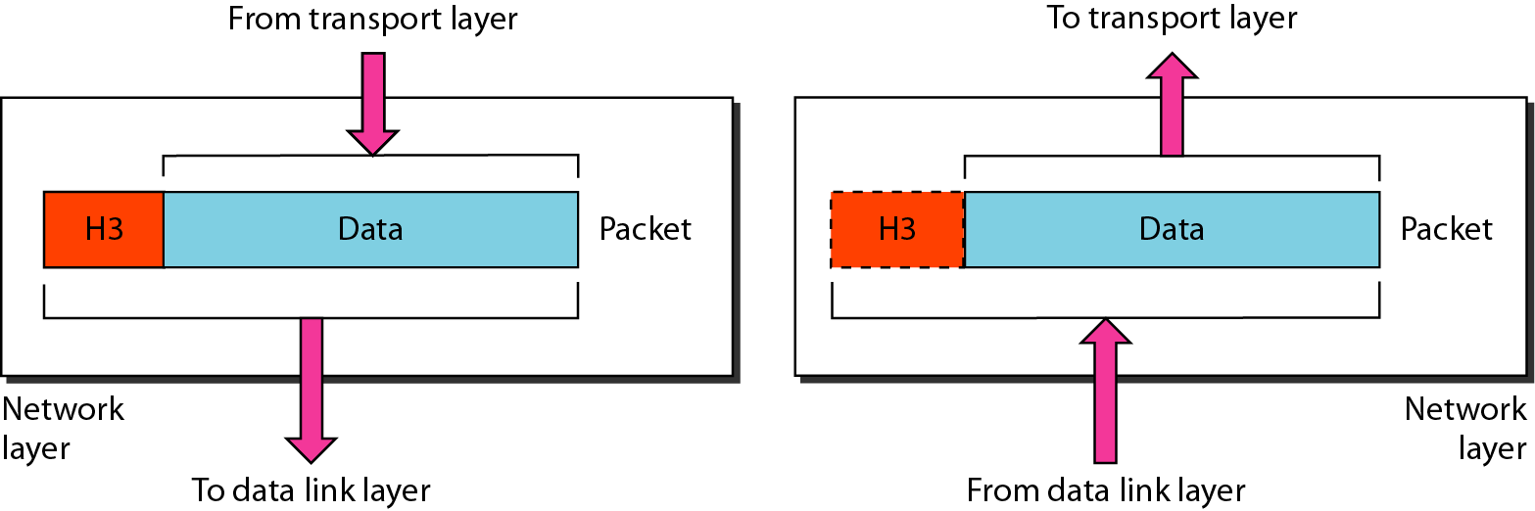
Layer 3 : Network layer
Figure 10 Shows the network layer information transmitted in OSI model.
Note
The network layer is responsible for the delivery of individual packets from the source host to the destination host.

Slide 19
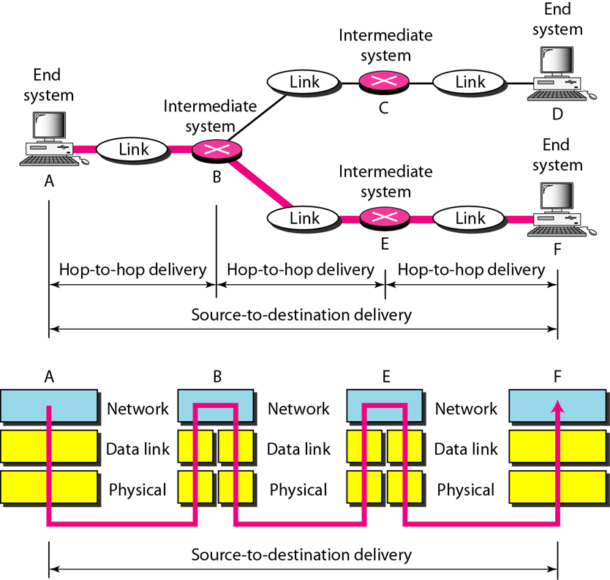
Source to destination delivery
Figure 11 Shows the network layer detailed information transmitted in OSI model.

Slide 20
Layer 4: Transport Layer
Manages transmission packets
Repackages long messages when necessary into small packets for transmission
Reassemble packets in the correct order to get the original message.
Handles error recognition and recovery.
Transport layer at receiving acknowledges packet delivery.
Resends missing packets
Transport Layer is responsible for end-to-end connectivity. It is also known as the heart of OSI Layers. Following tasks are performed at the Transport Layer : -
Identifying Service
Multiplexing & De-multiplexing
Segmentation
Sequencing & Reassembling
Error Correction
Flow Control
Transport
Notes:
The basic function of the Transport Layer is to take data from the Session Layer (Layer 5), split it up into smaller units (as necessary), and pass these units on to the Network Layer. It is then also responsible for ensuring that all the pieces are received correctly and reassembled in the correct order.
Typically the Transport Layer will create a distinct Network Layer connection for each Transport connection requested by the Session Layer. However, depending on the data load and the capacity of a single Session channel:
multiple Network connections might be used to support a single high-bandwidth Session connection, or
one high-bandwidth Network connection might be used to support several Session connections.
The Transport Layer also determines what Type of Service to provide to the Session Layer and, ultimately, to the network users. For example:
an error-free, point-to-point channel, guaranteeing data is delivered in the correct order (the most common type of service),
transport of isolated messages with no guarantee of correct ordering, or
message broadcast to multiple destinations
Transport is the first true end-to-end layer, i.e. the Transport protocol communicates between end parties and not to any of the intermediaries.

Slide 21
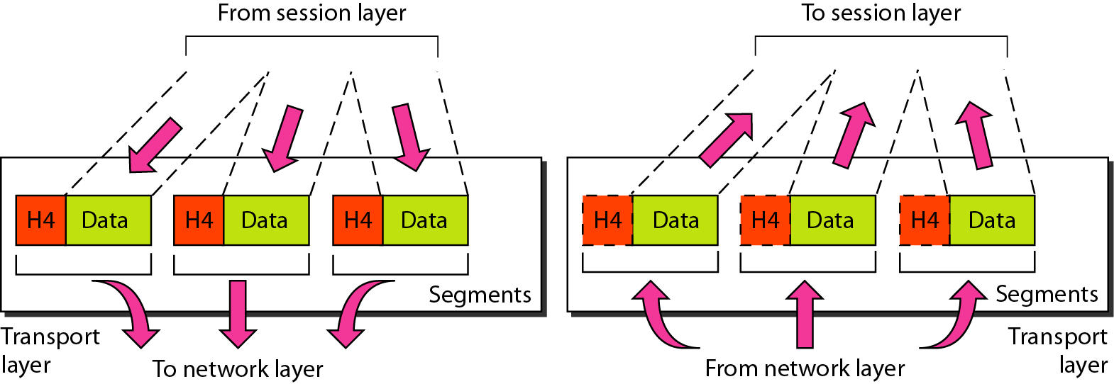
Transport layer
Figure 12 Shows the transport layer information transmitted in OSI model.
Note
The transport layer is responsible for the delivery of a message from one process to another.

Slide 22
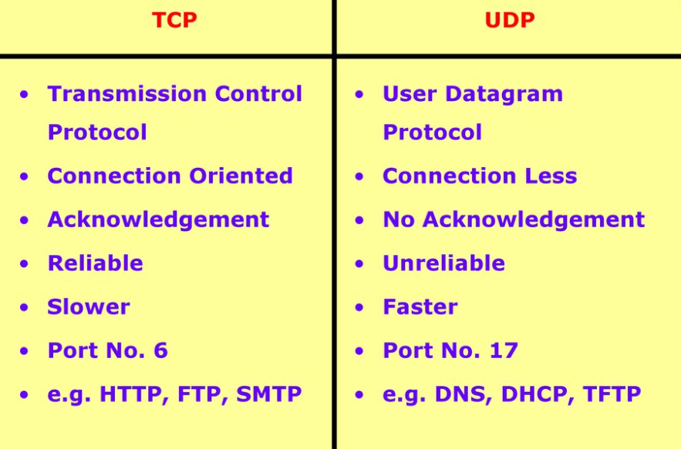
Identify Service
Figure 13 TCP Vs UDP

Slide 23
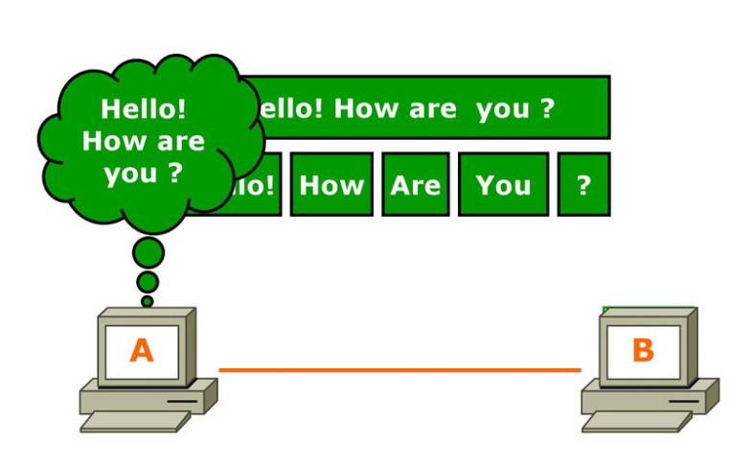
Segmentation
Figure 14 Segmentation process

Slide 24
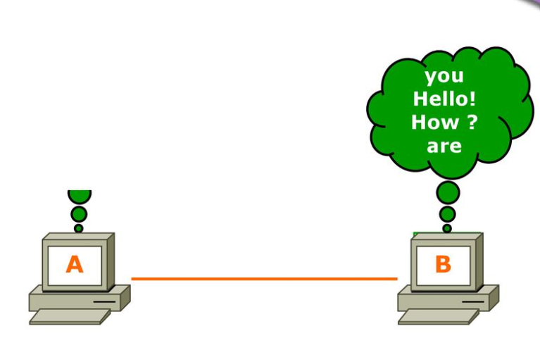
Sequence & Reassembling
Figure 15 Sequence & Reassembly

Slide 25
Layer 5: Session Layer
Allows two applications on different computers to establish, use, and end a session.e.g. file transfer, remote login
Establishes dialog control -Regulates which side transmits, plus when and how long it transmits.
Performs token management and synchronization.
Session Layer is responsible for establishing, maintaining and terminating session. Session ID works at Session Layer.
Examples :
RPC - Remote Procedure Call
SQL - Structured Query Language
NFS - Network File System
Notes:
The Session Layer allows the establishment of sessions between machines, e.g. to allow remote logins to a multi-user system, or to perform file transfer between machines.
One of the Session services is dialogue control; if the communications are half-duplex then the session layer can manage which entity sends when.
A related service is token management. In some protocols it is essential that both entities do not attempt the same operation simultaneously. Possession of a token permits the operation.
The other main Session service is synchronization. As an example consider attempting a 2-hour file transfer between machines which crash on average once an hour. The synchronization service provides a means for checkpoints to be inserted into the data stream so that, after a crash, only data sent since the last checkpoint needs to be re-transmitted.

Slide 26
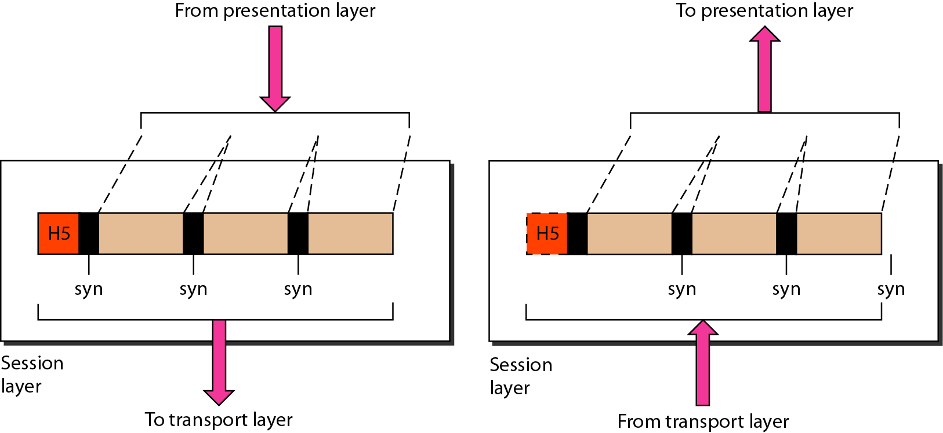
Session layer
Figure 16 Shows the session layer information transmitted in OSI model.
Note
The session layer is responsible for dialog control and synchronization.

Slide 27
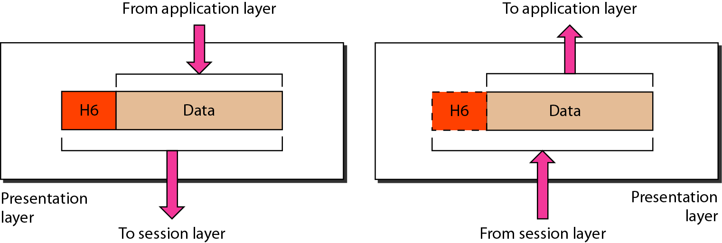
Layer 6 -Presentation layer
Figure 17 Shows the presentation layer information transmitted in OSI model.
Note
The presentation layer is responsible for translation, compression, and encryption.

Slide 28
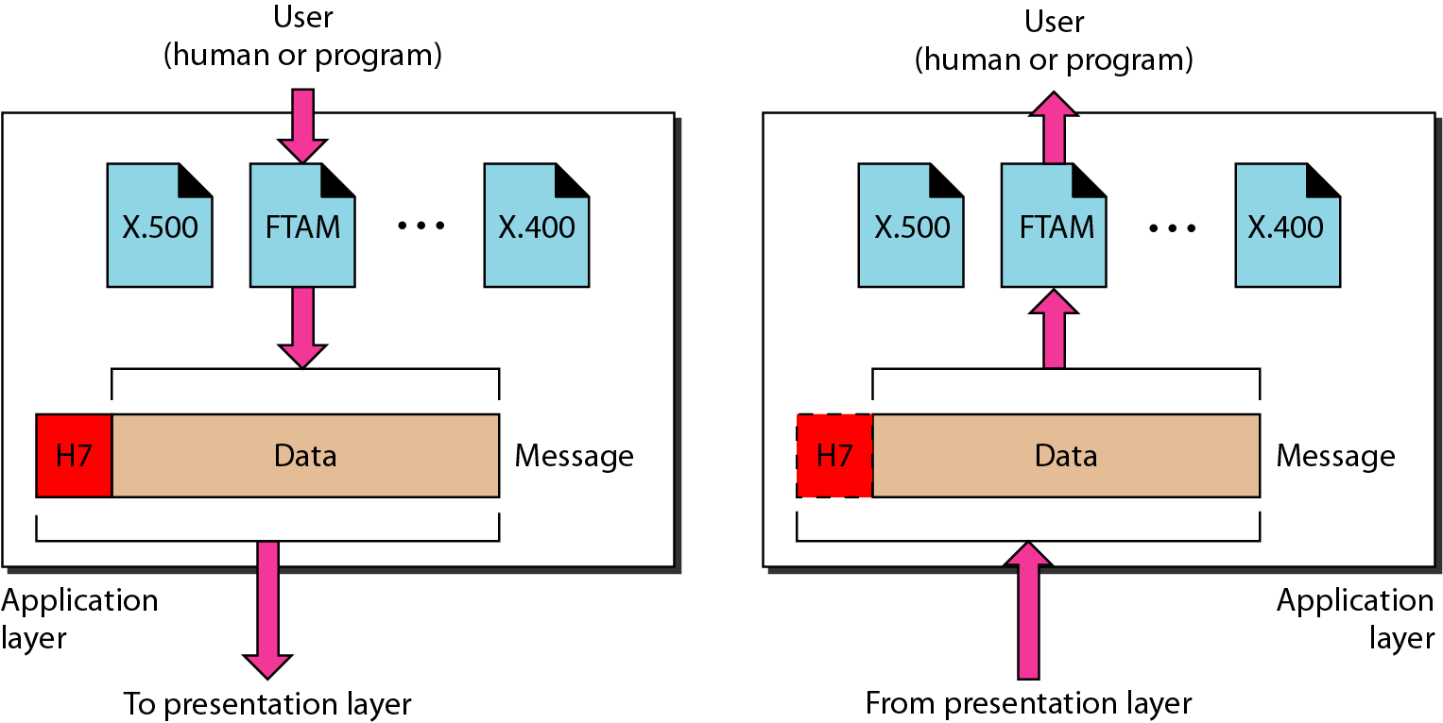
Layer 7 - Application layer
Figure 18 Shows the application layer information transmitted in OSI model.
Note
The application layer is responsible for providing services to the user.

Slide 29
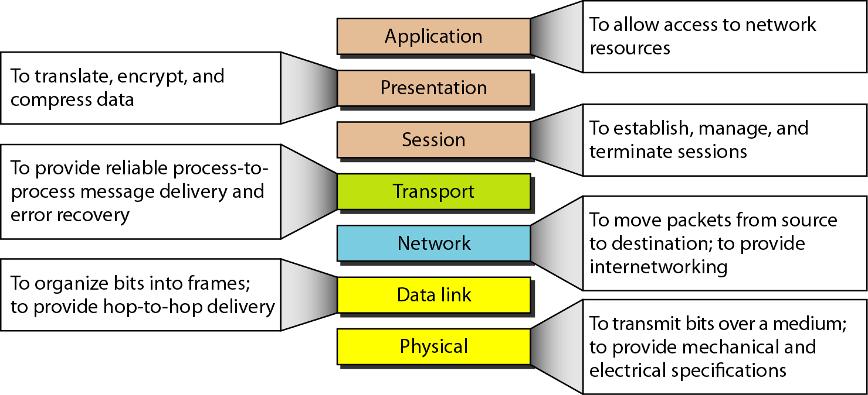
Summary of layers
Figure 19 Presents the summary of layers of OSI model.

Slide 30
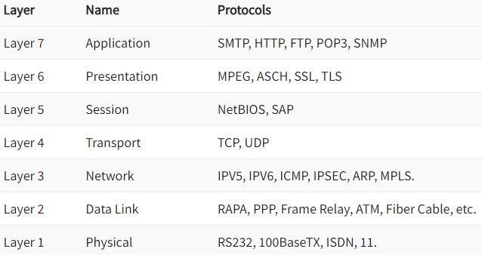
Protocol supported at various layers

Slide 31
Protocols at Application layer
TELNET: Telnet stands for the TELetype NETwork. It helps in terminal emulation. It allows Telnet clients to access the resources of the Telnet server. It is used for managing files on the internet. It is used for the initial setup of devices like switches. The telnet command is a command that uses the Telnet protocol to communicate with a remote device or system. Port number of telnet is 23.
FTP: FTP stands for file transfer protocol. It is the protocol that actually lets us transfer files. It can facilitate this between any two machines using it. But FTP is not just a protocol but it is also a program. FTP promotes sharing of files via remote computers with reliable and efficient data transfer. The Port number for FTP is 20 for data and 21 for control.
TFTP: The Trivial File Transfer Protocol (TFTP) is the stripped-down, stock version of FTP, but it’s the protocol of choice if you know exactly what you want and where to find it. It’s a technology for transferring files between network devices and is a simplified version of FTP. The Port number for TFTP is 69.

Slide 32
Continued….
SMTP: It stands for Simple Mail Transfer Protocol. It is a part of the TCP/IP protocol. Using a process called “store and forward,” SMTP moves your email on and across networks. It works closely with something called the Mail Transfer Agent (MTA) to send your communication to the right computer and email inbox. The Port number for SMTP is 25.
SNMP: It stands for Simple Network Management Protocol. It gathers data by polling the devices on the network from a management station at fixed or random intervals, requiring them to disclose certain information. It is a way that servers can share information about their current state, and also a channel through which an administrate can modify pre-defined values. The Port number of SNMP is 161(TCP) and 162(UDP).
DNS: It stands for Domain Name System. Every time you use a domain name, therefore, a DNS service must translate the name into the corresponding IP address. For example, the domain name www.abc.com might translate to 198.105.232.4. The Port number for DNS is 53

Slide 33
Continued…
DHCP: It stands for Dynamic Host Configuration Protocol (DHCP). It gives IP addresses to hosts. There is a lot of information a DHCP server can provide to a host when the host is registering for an IP address with the DHCP server. Port number for DHCP is 67, 68.

Slide 34
Presentation layer protocols
MPEG: The Moving Pictures Experts Group's standard for the compression and coding of motion video for CD's is very popular. QuickTime: This is for use with Machintosh or Power PC programs, it manages audio and video applications.
SSL (Secure Socket Layer) and TLS (Transport Layer Security) are popular cryptographic protocols that are used to imbue web communications with integrity, security, and resilience against unauthorized tampering.

Slide 35
Session layer protocols
NetBIOS is a non-routable OSI Session Layer 5 Protocol and a service that allows applications on computers to communicate with one another over a local area network (LAN). NetBIOS was developed in 1983 by Sytek Inc. as an API for software communication over IBM PC Network LAN technology.
SAP: The protocol used by SAP programs that communicate using the NI interface is called the SAP Protocol. This is an enhanced version of the TCP/IP protocol, which has been supplemented by one length field and some options for error information .

Slide 36
Transport layer protocol
Transmission Control Protocol (TCP) - is a transport protocol that is used on top of IP to ensure reliable transmission of packets. TCP includes mechanisms to solve many of the problems that arise from packet-based messaging, such as lost packets, out of order packets, duplicate packets, and corrupted packets.
User Datagram Protocol (UDP) – a communications protocol that facilitates the exchange of messages between computing devices in a network. It's an alternative to the transmission control protocol (TCP). In a network that uses the Internet Protocol (IP), it is sometimes referred to as UDP/IP.

Slide 37
Internet protocol
IPV6: Internet Protocol version 6 is the most recent version of the Internet Protocol, the communications protocol that provides an identification and location system for computers on networks and routes traffic across the Internet.
ICMP: ICMP is a network level protocol. ICMP messages communicate information about network connectivity issues back to the source of the compromised transmission. It sends control messages such as destination network unreachable, source route failed, and source quench.
MPLS: Multiprotocol Label Switching, or MPLS, is a networking technology that routes traffic using the shortest path based on “labels,” rather than network addresses, to handle forwarding over private wide area networks.
ARP: ARP is the protocol used to associate the IP address to a MAC address. When a host wants to send a packet to another host, say IP address 10.5. 5.1, on its local area network (LAN), it first sends out (broadcasts) an ARP packet.

Slide 38
Data Link Layer Protocols
PPP: In computer networking, Point-to-Point Protocol is a data link layer communication protocol between two routers directly without any host or any other networking in between. It can provide connection authentication, transmission encryption, and data compression.
ATM: ATM is a core protocol used in the SONET/SDH backbone of the public switched telephone network (PSTN) and in the Integrated Services Digital Network (ISDN), but has largely been superseded in favor of next-generation networks based on Internet Protocol (IP) technology

Slide 39
Physical layer Protocols
ISDN: ISDN or Integrated Services Digital Network is a circuit-switched telephone network system that transmits both data and voice over a digital line. You can also think of it as a set of communication standards to transmit data, voice, and signaling. These digital lines could be copper lines.
100Base-TX: 100Base-TX is an Ethernet networking standard (IEEE 802.3u standard.) that supports up to 100 Mbps transfer speed. 100Base-TX was also called as FastEthernet, because Ethernet was 10 Mbps that time and FastEthernet was faster than Ethernet.

Slide 40
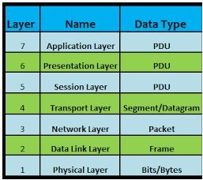
PDU (Protocol Data Unit)

Slide 41
Questions
Which type of communication will send a message to a group of host destinations simultaneously?
unicast
anycast
multicast
Broadcast
What process is used to receive transmitted data and convert it into a readable message?
encapsulation
access control
decoding
flow control
What is done to an IP packet before it is transmitted over the physical medium?
It is segmented into smaller individual pieces.
It is tagged with information guaranteeing reliable delivery.
It is encapsulated in a Layer 2 frame.
It is encapsulated into a TCP segment.

Slide 42
Questions
What process is used to place one message inside another message for transfer from the source to the destination?
decoding
access control
encapsulation
flow control
A web client is sending a request for a webpage to a web server. From the perspective of the client, what is the correct order of the protocol stack that is used to prepare the request for transmission?
Ethernet, IP, TCP, HTTP
HTTP, TCP, IP, Ethernet
HTTP, IP, TCP, Ethernet
Ethernet, TCP, IP, HTTP
References :
Data Communications and Networking’ by Forouzan, 5th Edition, 2013
Netacad course

